Slide 1
Quantum Machine Learning
Laurent Boué
Overall survey of the field Live demo: Nearest neighbor classifier on a quantum computer

Slide 2
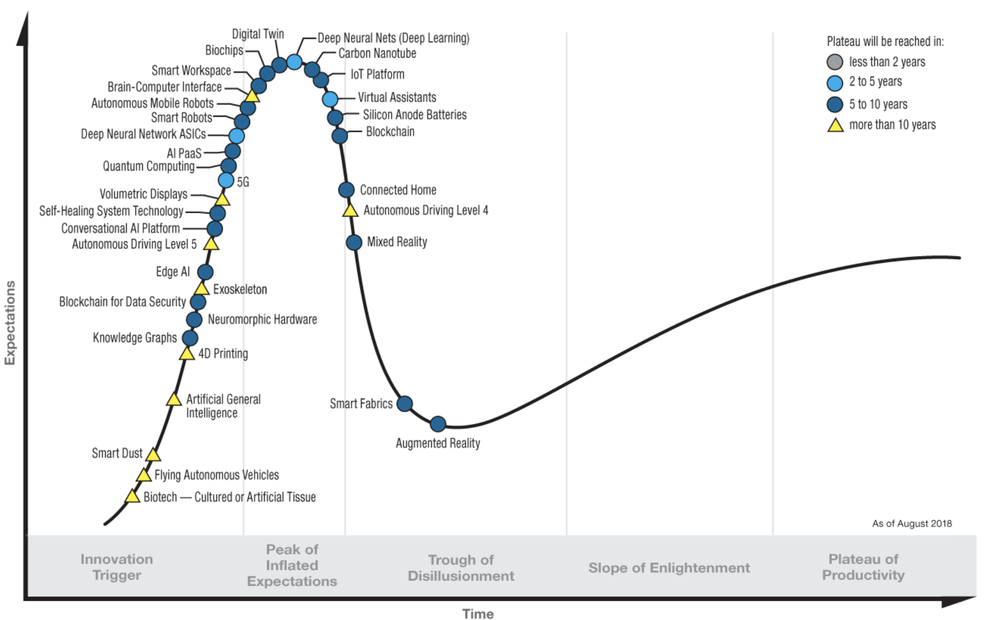
Expectation management: Gartner hype cycle for emerging technologies

Slide 3
Outline
From bits to qubits
Models of quantum computation:
- Domain-specific quantum annealing
- Universal quantum logic gates
Traditional quantum algorithms: a reality check
Quantum chips as AI accelerators
Live demo: nearest neighbor classifier on a quantum computer

Slide 4
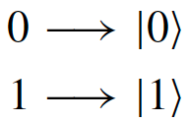
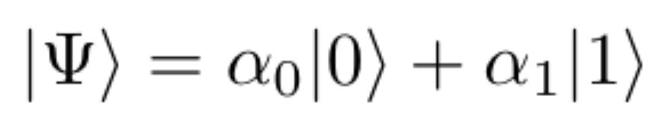
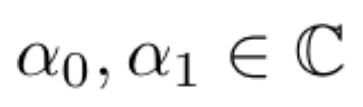
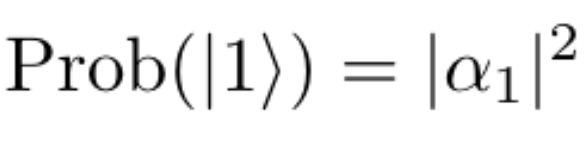
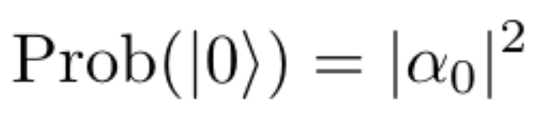
From bits to qubits
General state of qubit: superposition (linear combination basis vectors)
Measurement of a quantum state: “wavefunction collapse”

Slide 5
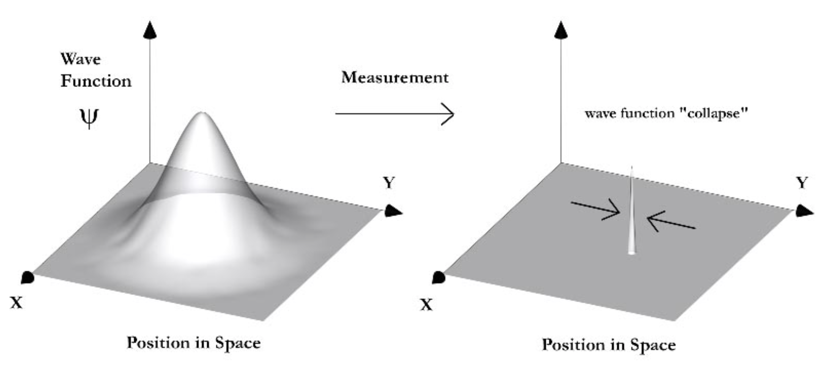
From bits to qubits
Bloch sphere
General state of qubit: superposition (linear combination basis vectors)
Measurement of a quantum state: “wavefunction collapse”
Quantum state defines a probability density function Measurements sample that distribution

Slide 6
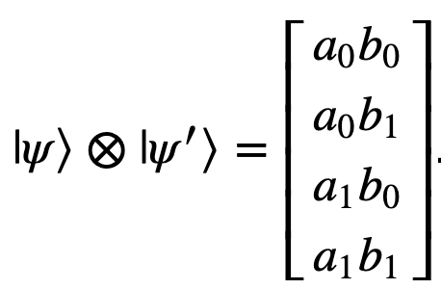
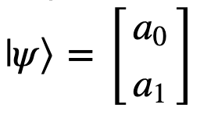
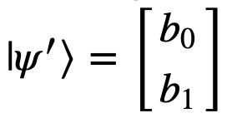
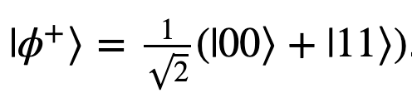
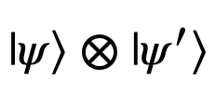
Multiple qubits
Tensor product between qubits
Not all vectors in tensor product space can be factorized as products!
“Bell state”:
Cannot be expressed as
Strong correlations between random variables that have no classical analog
Quantum entanglement

Slide 7
Multiple qubits
Tensor product between qubits
Not all vectors in tensor product space can be factorized as products!
“Bell state”:
Cannot be expressed as
Strong correlations between random variables that have no classical analog
Quantum entanglement
Simulating a quantum system on a classical computer:
Quantum computer with n qubits can be in any superposition of 2^{n} states simultaneously
n = 50 qubits → 2⁵⁰ complex numbers ~ 18 PB of memory. (PB = 1 million GB)

Slide 8
Quantum annealing (1/3)
First company to have commercial offering Price tag ~ $15m
D-Wave systems
Liquid helium refrigeration
(for comparison interstellar space ~ 2.7K)
Shielded enclosure interfaced with IO subsystem
Customers include: Lockheed Martin, NASA, Google, Volkswagen, Temporal Defense Systems…

Slide 9
Quantum annealing (2/3)
Solving optimization problems on rugged energy landscapes
Protein folding Modelling chemical reactions Material discovery Pharmaceutical drug design Satisfiability problems, traveling salesman… Portfolio management Loss functions in machine learning

Slide 10
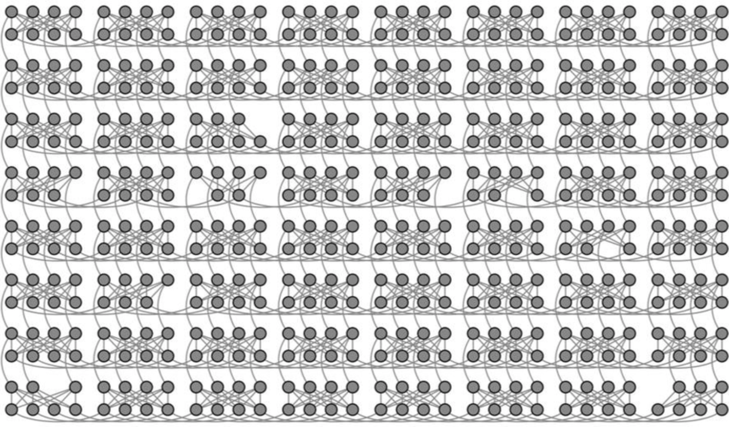
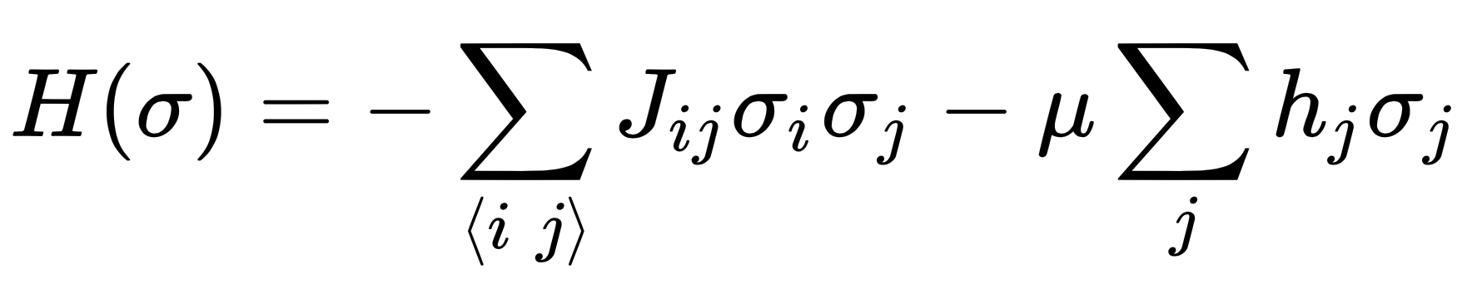
Quantum annealing (2/3)
Solving optimization problems on rugged energy landscapes
Protein folding Modelling chemical reactions Material discovery Pharmaceutical drug design Satisfiability problems, traveling salesman… Portfolio management Loss functions in machine learning
Constrained to transverse field Ising model (~ quadratic unconstrained binary optimization QUBO)

Slide 11
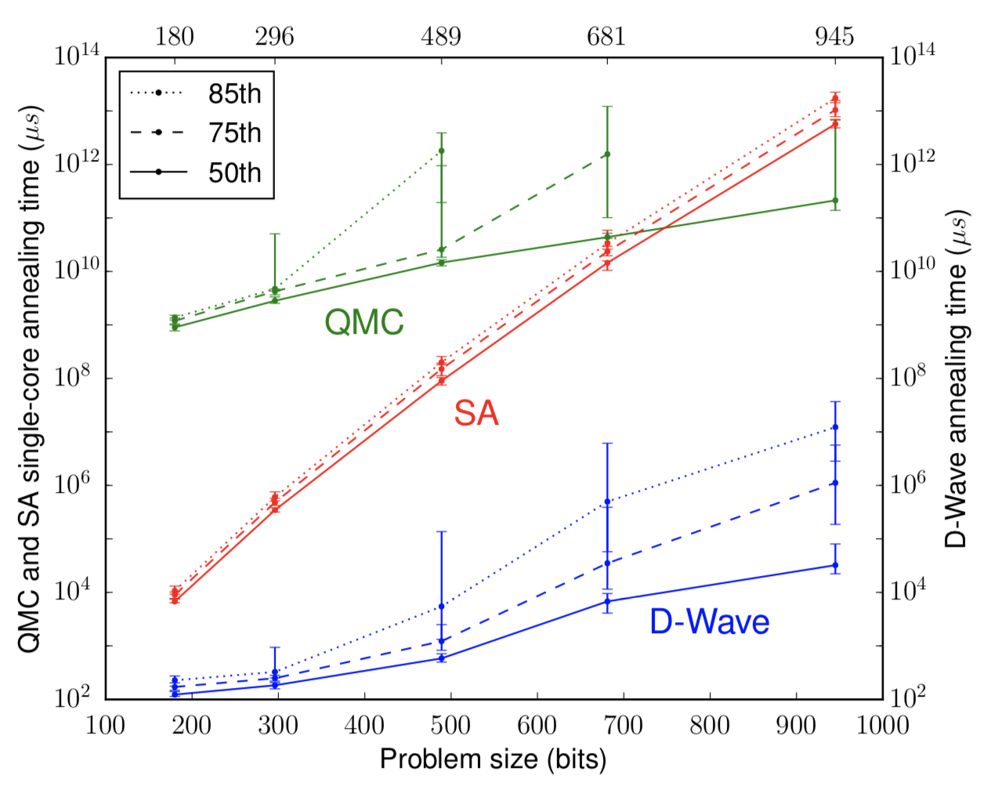
Quantum annealing (3/3)
Google AI Quantum
Quantum annealing overcomes barriers exponentially faster than simulated annealing
~ 2000 qubits but very specific architecture

Slide 12
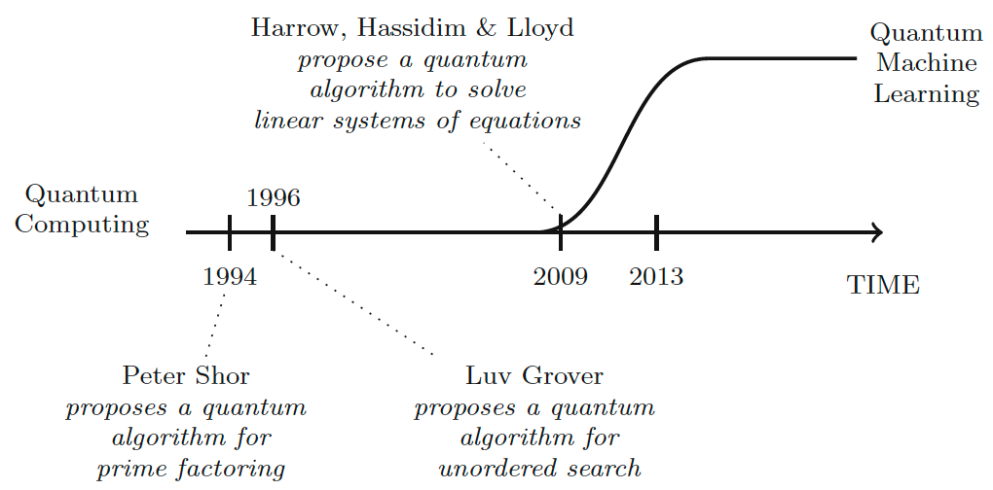
Traditional quantum algorithms
None of these algorithms can be formulated as quantum annealing problems…
Logic quantum gates: designing general (universal) circuits

Slide 13
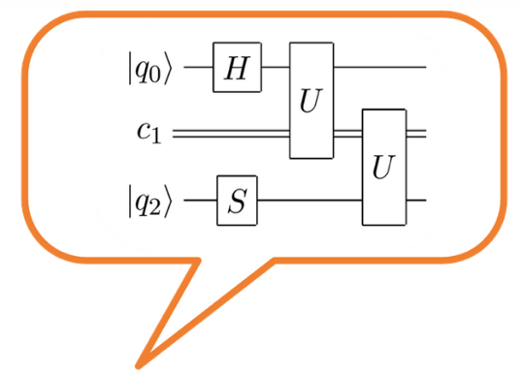
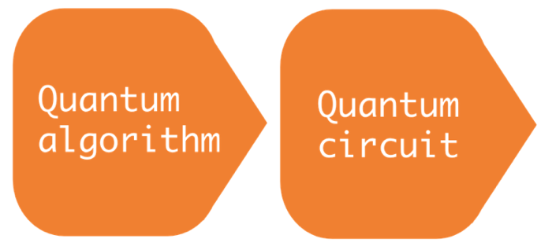
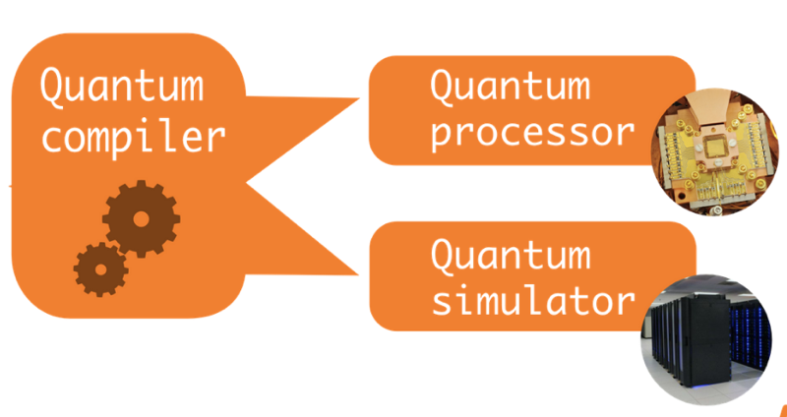
Logic quantum gates (1/4)
”high-level” code
”low-level” circuits
Completely analogous to classic software application
Universal model: any algorithms can be expressed using this quantum gates
In practice, algorithms are usually written at gate-level
(compilers are still very new…)

Slide 14
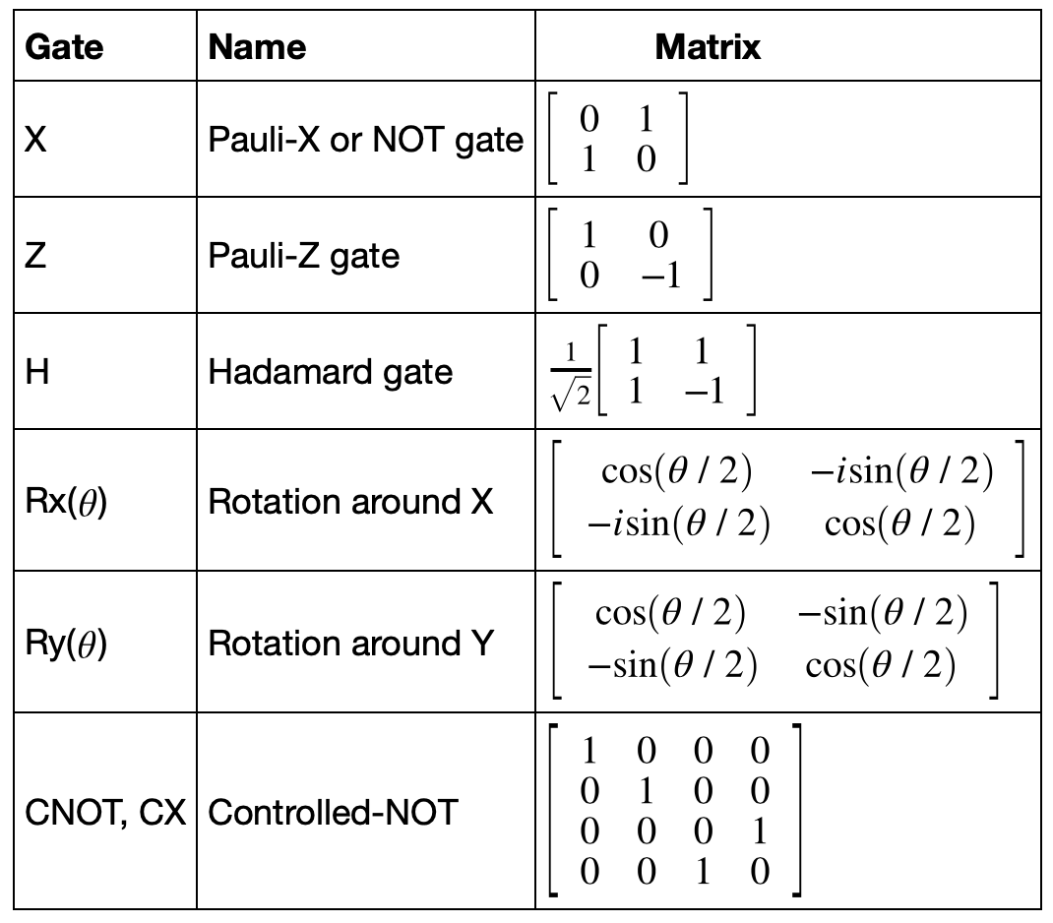
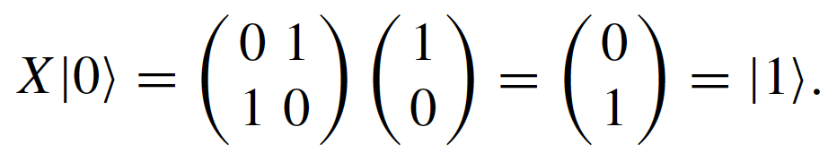
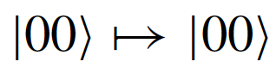
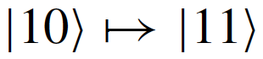
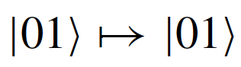
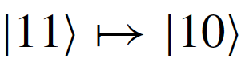
Logic quantum gates (2/4)
Common gates include
Unitary matrices: 2x2 for single qubit 4x4 for 2-qubit gate…
NOT gate
CNOT gate
Gates can be parametrized by a continuous value: Playground for linear algebra!

Slide 15
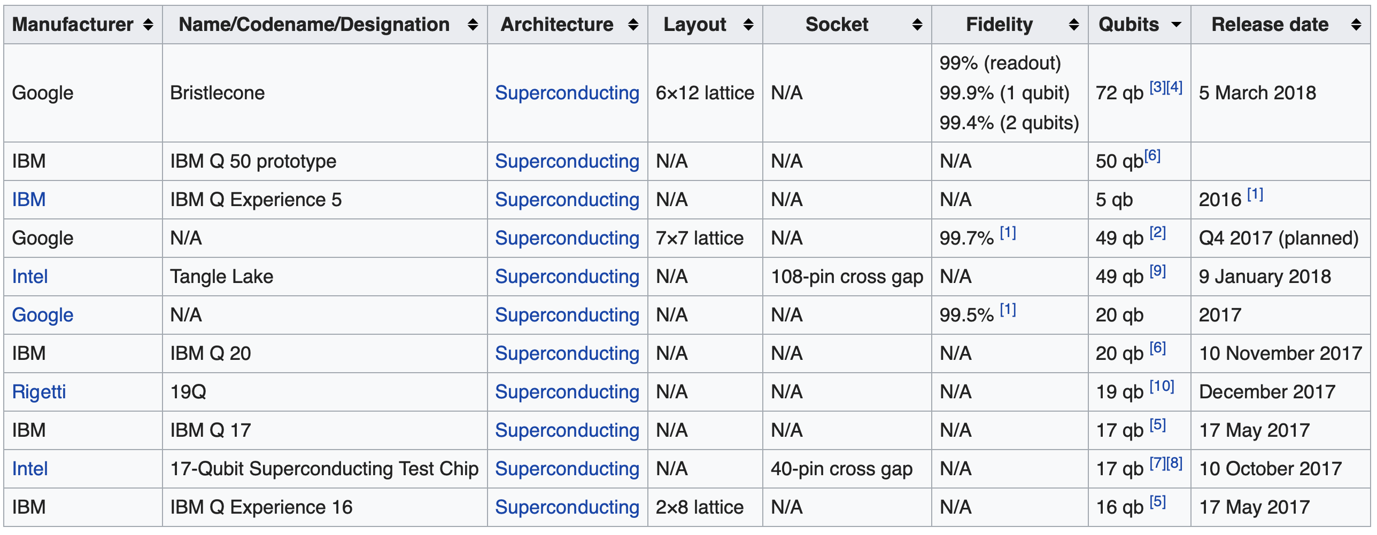
Logic quantum gates (3/4)
Existing systems: Decoherence time ~ maximum 100 gates
Error correction: no-cloning theorem…

Slide 16
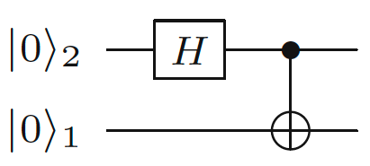
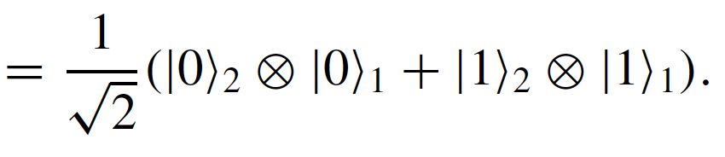
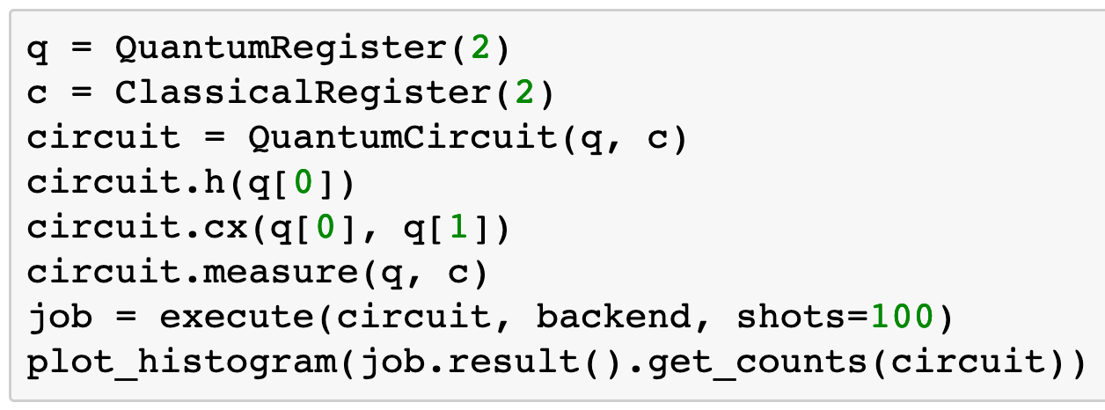
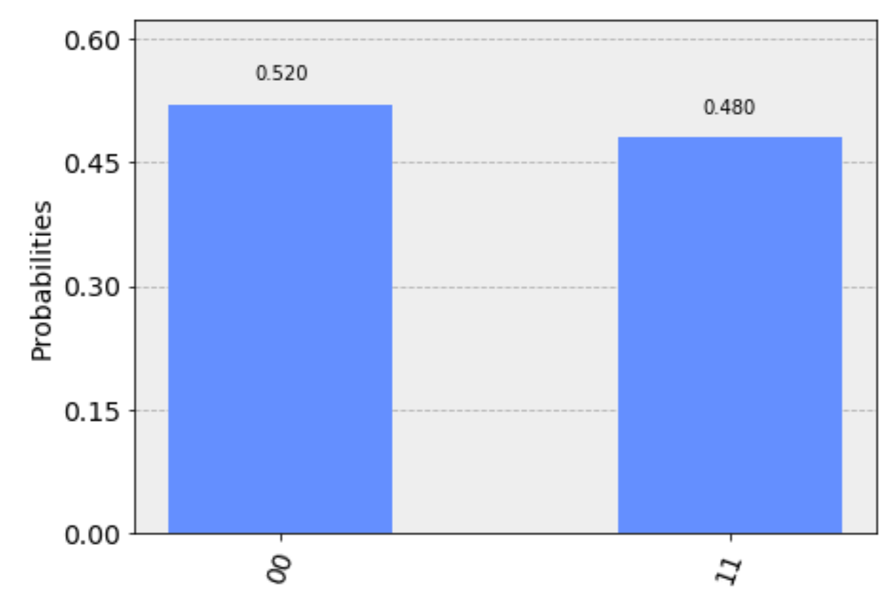
Logic quantum gates (4/4)
Example circuit: Create entangled state on IBM Q5 (bow-tie architecture)
Sampling superposition state 100 times
Longer circuit would suffer from noisy results…

Slide 17
Traditional quantum algorithms: back to the “usual suspects”

Slide 18
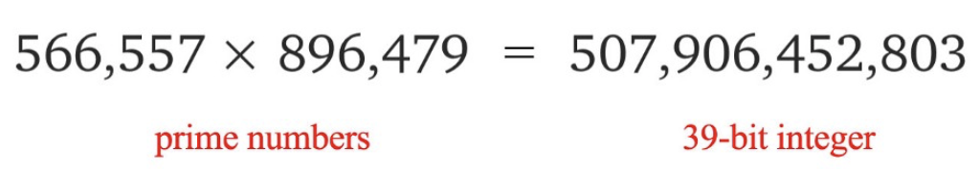
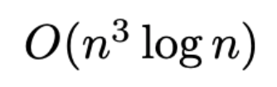
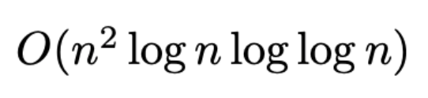
Traditional quantum algorithms: back to the “usual suspects” (1/3)
Shor’s algorithm: Given an integer N, find its prime factors Break public-key cryptography schemes (RSA encryption...)
Multiplication is easy to verify but factorization is much harder
Best classical result ~ exponential in n
Quantum: polynomial in n
exponential speedup
Number of gates ~ 10⁸ for n = 2048…

Slide 19
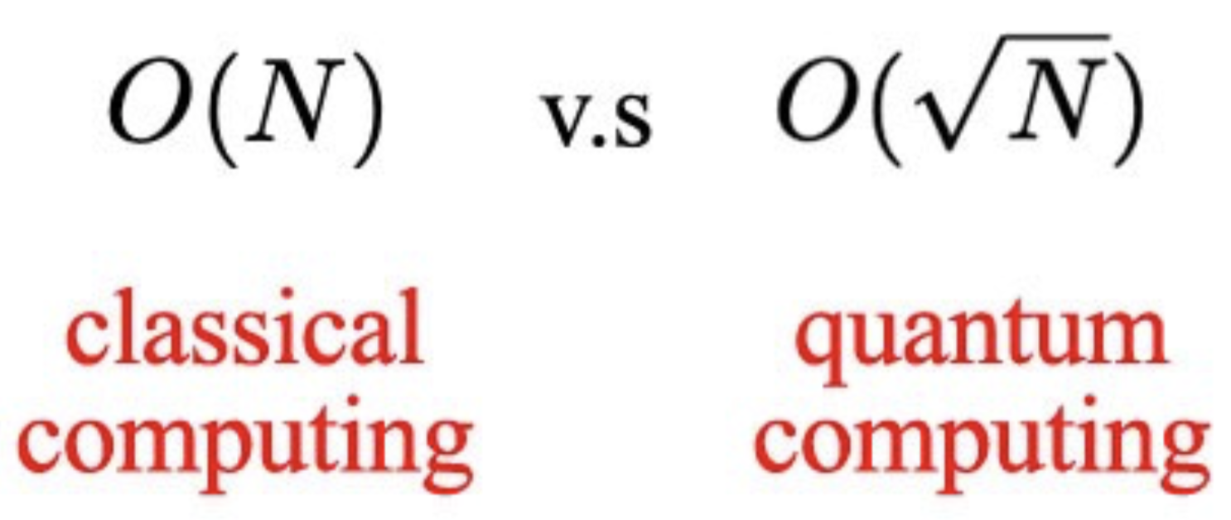
Traditional quantum algorithms: back to the “usual suspects” (2/3)
Grover’s search algorithm
Search for subset of items that satisfy a criteria in an unstructured set of N items
Quadratic speedup in the expected number of necessary queries
(basic idea: evaluate search predicate on use superposition of all items in the database)

Slide 20
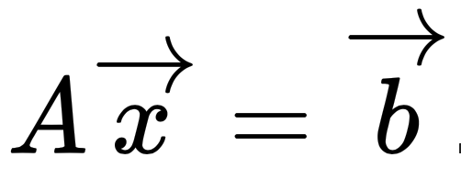
Traditional quantum algorithms: back to the “usual suspects” (3/3)
Solving linear systems: HHL algorithm
Given A and b, find x such that:

Slide 21


Traditional quantum algorithms: back to the “usual suspects” (3/3)
Solving linear systems: HHL algorithm
Given A and b, find x such that:
Exponential speedup in size of matrix NxN

Slide 22
Traditional quantum algorithms: back to the “usual suspects” (3/3)
Solving linear systems: HHL algorithm
Given A and b, find x such that:
Exponential speedup in size of matrix NxN
Unfortunately many constraints: sparse matrices with low condition number, expectation values of projections on x (no access to solution vector itself)…
Experimental (very complicated) quantum circuit implementing HHL: 2x2 matrix inversion…
“Experimental Quantum Computing to Solve Systems of Linear Equation”, PRL
State preparation (loading data into quantum computer) and gathering read-out statistics (more or less) destroy quantum advantage…

Slide 23
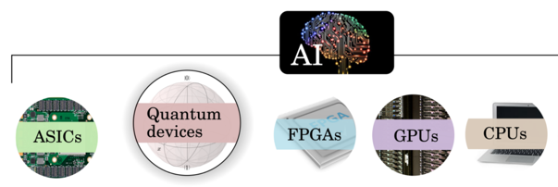
What are quantum computers good for?
an emerging interdisciplinary research area
“Trendy” idea: use early generation quantum devices as hardware accelerators for machine learning tasks

Slide 24
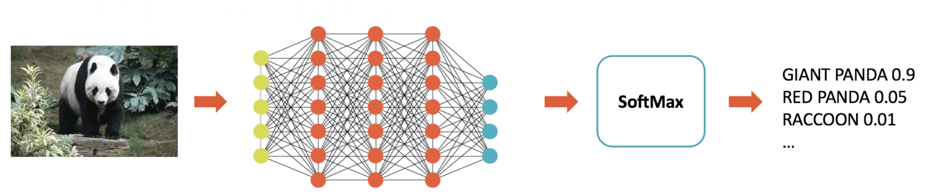
Deep learning in a nutshell: feedforward (memory-less) architectures
Linear mappings from layer to layer: fused matrix multiplications and accumulate (MACs)

Slide 25
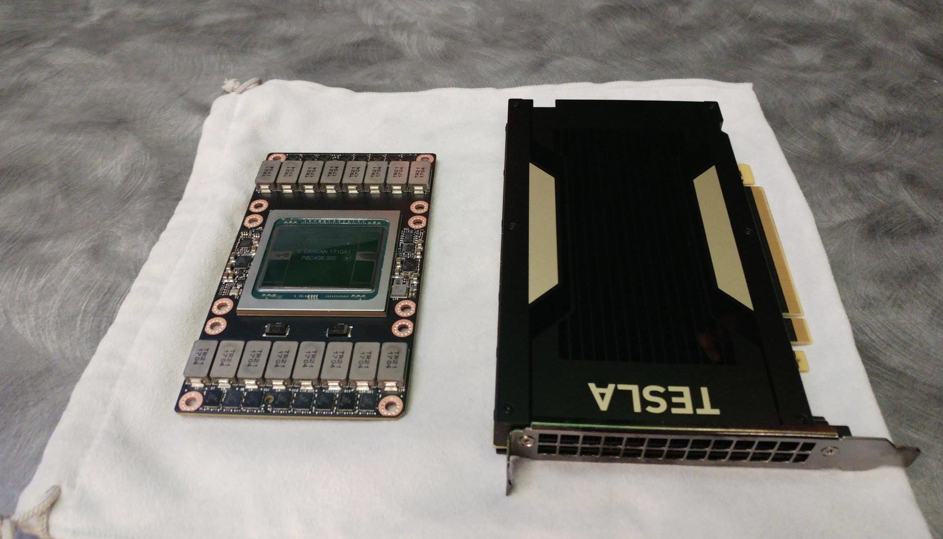
Deep learning in a nutshell: feedforward (memory-less) architectures
Linear mappings from layer to layer: fused matrix multiplications and accumulate (MACs)
Current generation of specialized AI hardware accelerators:
Tensor Core: 4x4 matrix multiply and accumulate / clock cycle Tesla V100 GPU contains 640 Tensor Cores

Slide 26
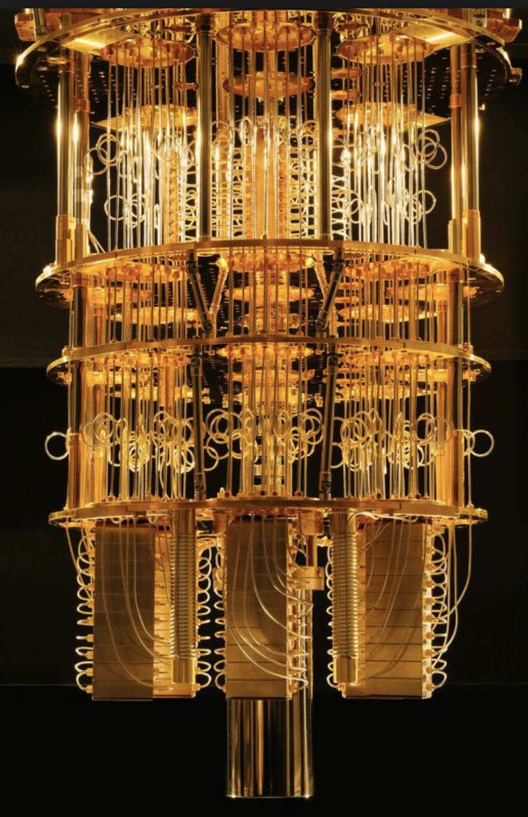
Deep learning in a nutshell: feedforward (memory-less) architectures
Linear mappings from layer to layer: fused matrix multiplications and accumulate (MACs)
Quantum gate = multiplication of large matrix
(potentially infinite) with similarly large vector Single operation on quantum computer!

Slide 27
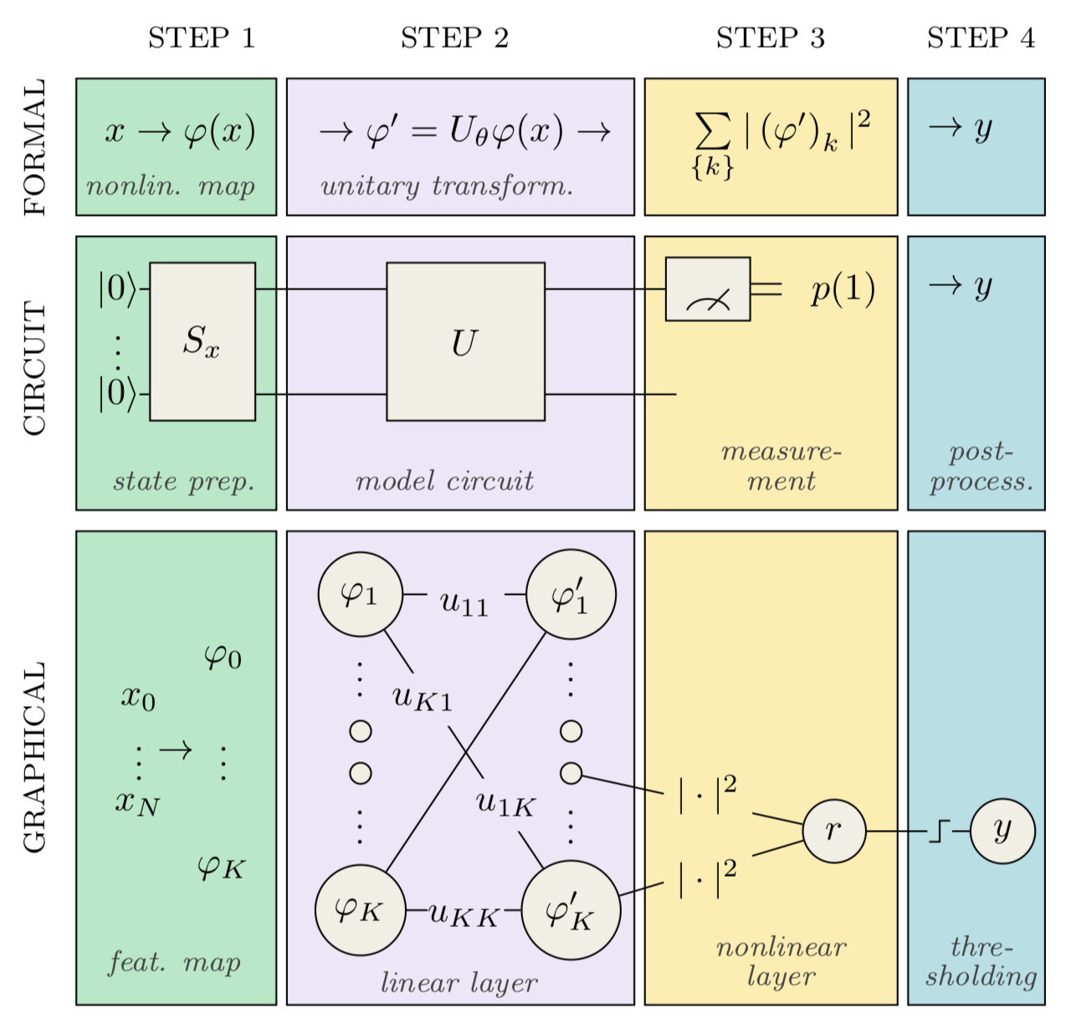
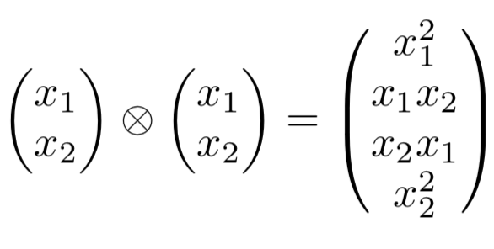
Quantum chips as AI accelerators
“Circuit-centric quantum classifiers”, arXiv:1804.00633
State preparation with tensor products generates nonlinearities
Bottlenecks: - Data encoding / Read out statistics
- Limited circuit depth (~ flexibility of ML model)

Slide 28
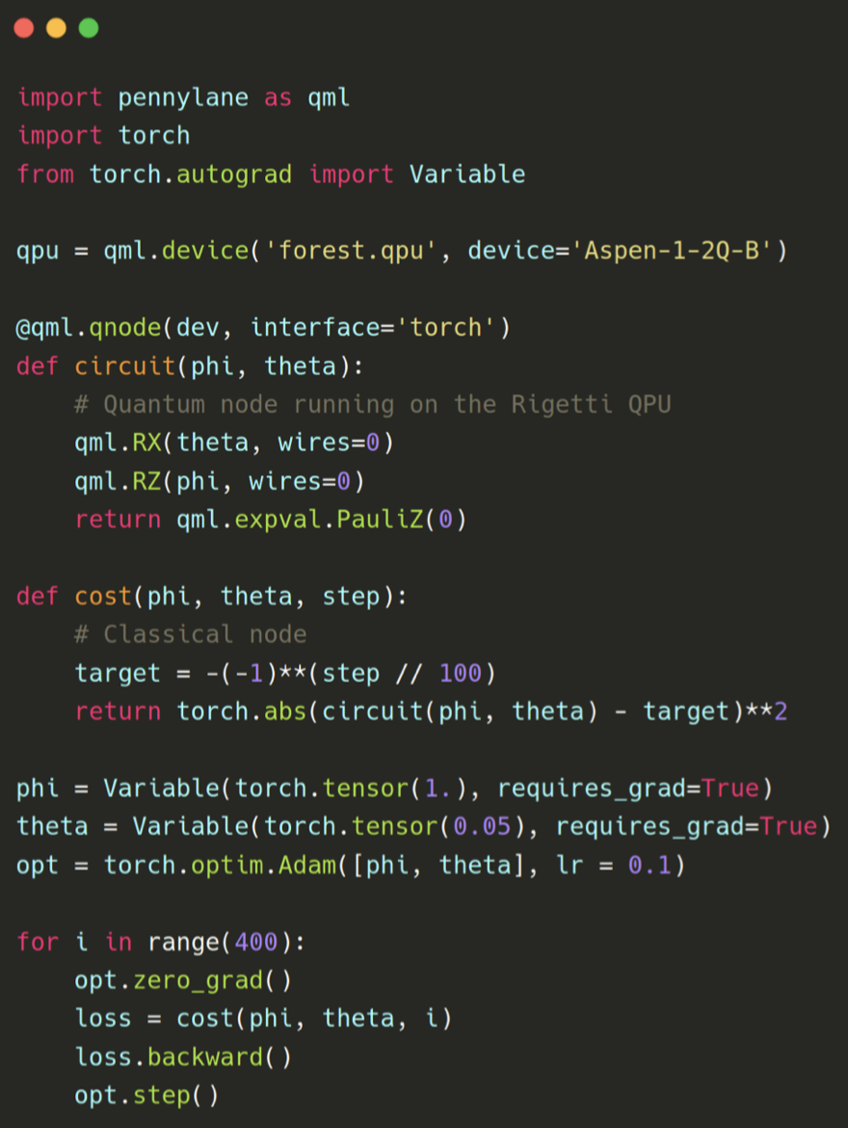
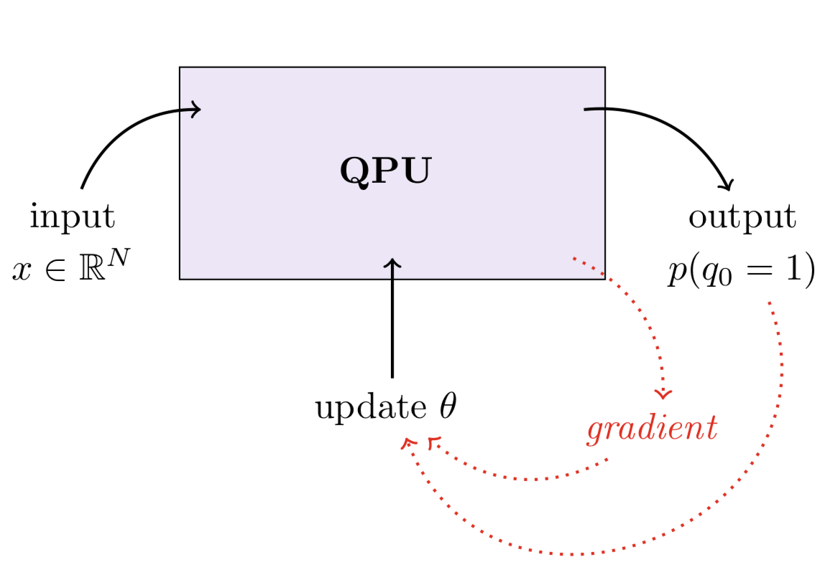
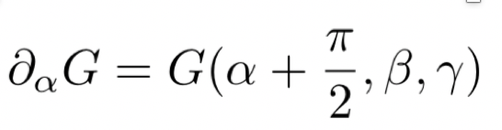
Variational circuits: hybrid quantum-classical technique for training!
Use QPU for ”hard to compute” cost function
Gradients provided by rotations on input data
“Classical” updates to the quantum system

Slide 29
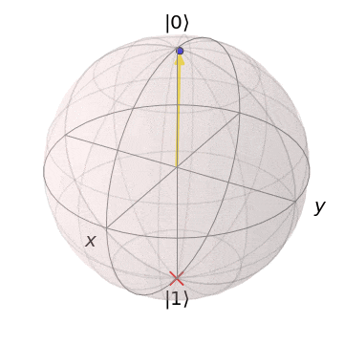
Variational circuits: hybrid quantum-classical technique for training!
Use QPU for ”hard to compute” cost function
Gradients provided by rotations on input data
“Classical” updates to the quantum system

Slide 30
